Slide 1
Anheuser Busch Project
Billy Nayden

Slide 2
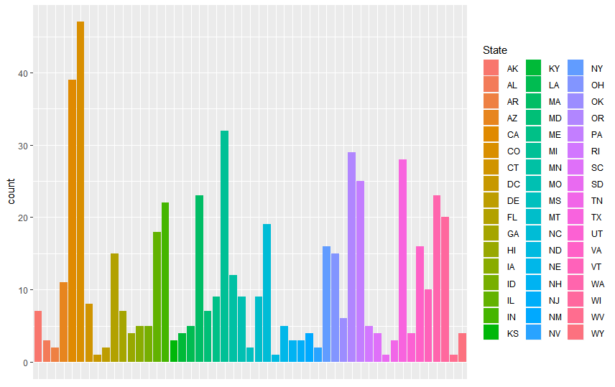
Breweries by State
CO | CA | MI | OR | TX | PA | WA | MA | IN | WI | NC | IL | VA | NY | OH | FL | MN | AZ | VT | MT | MO | ME | CT | MD | GA | AK | OK | RI | NE | LA | ID | IA | WY | UT | SC | NM | KY | HI | TN | NJ | NH | KS | AL | NV | MS | DE | AR | WV | SD | ND | DC
47 | 39 | 32 | 29 | 28 | 25 | 23 | 23 | 22 | 20 | 19 | 18 | 16 | 16 | 15 | 15 | 12 | 11 | 10 | 9 | 9 | 9 | 8 | 7 | 7 | 7 | 6 | 5 | 5 | 5 | 5 | 5 | 4 | 4 | 4 | 4 | 4 | 4 | 3 | 3 | 3 | 3 | 3 | 2 | 2 | 2 | 2 | 1 | 1 | 1 | 1

Slide 3
Missing Data
2692 different beers
62 missing ABVs
1005 missing IBUs

Slide 4
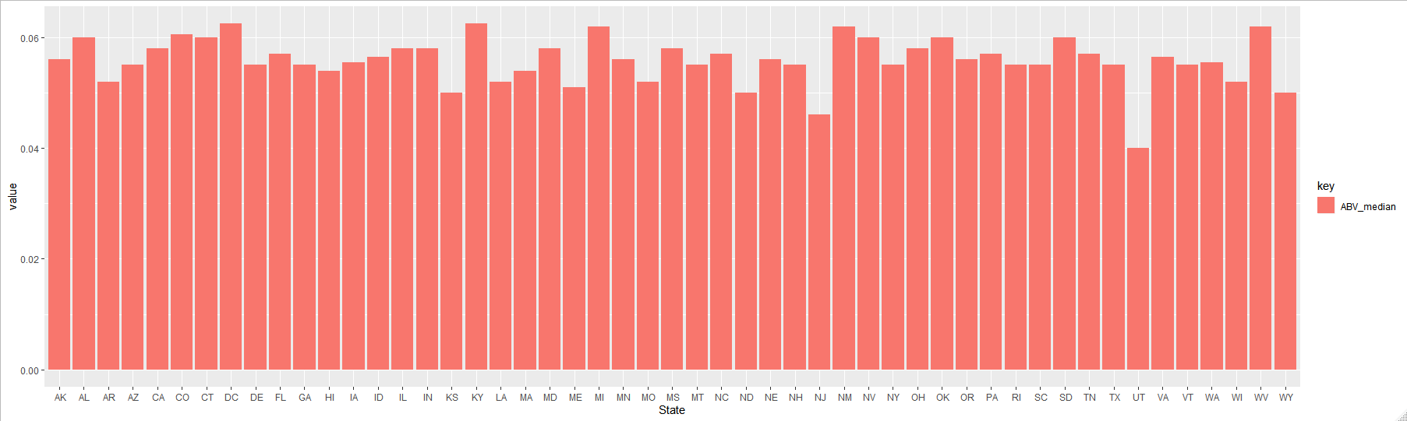
Median ABV by State

Slide 5
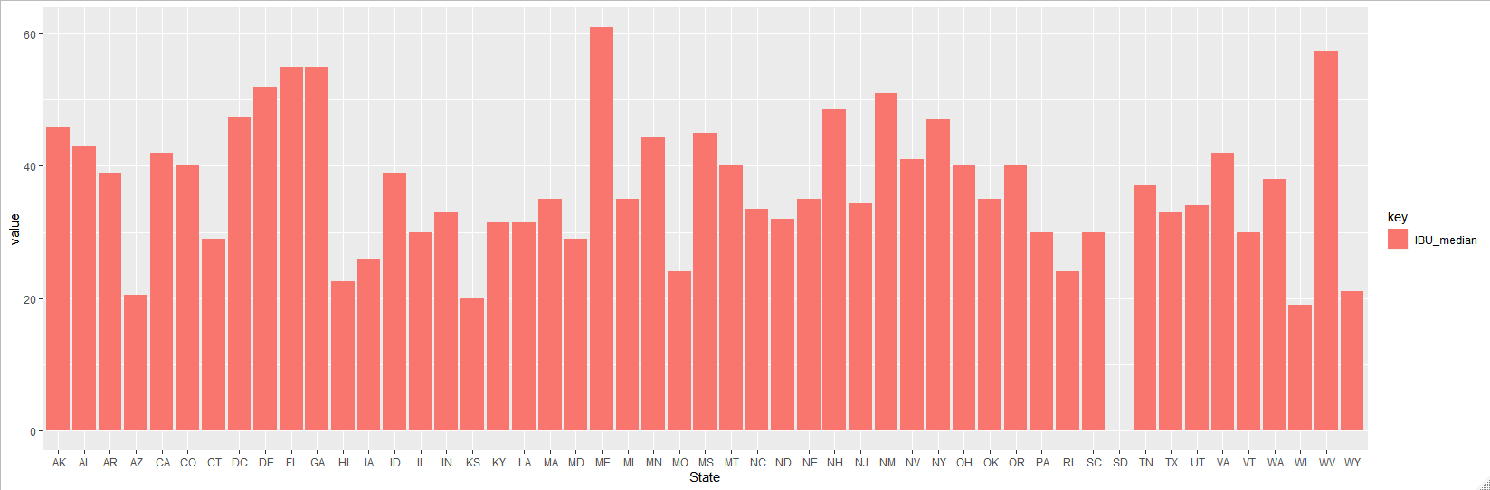
Median IBU by State

Slide 6
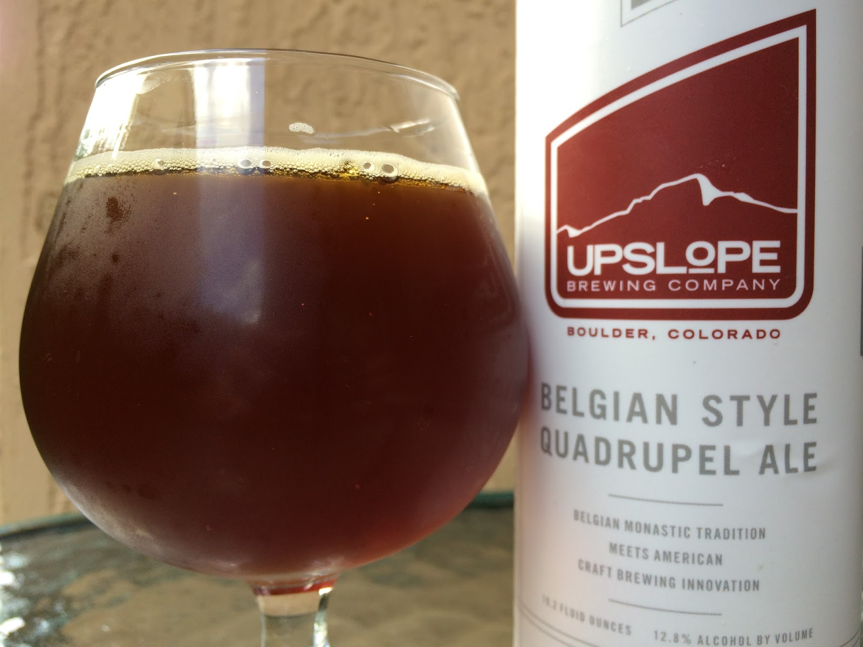
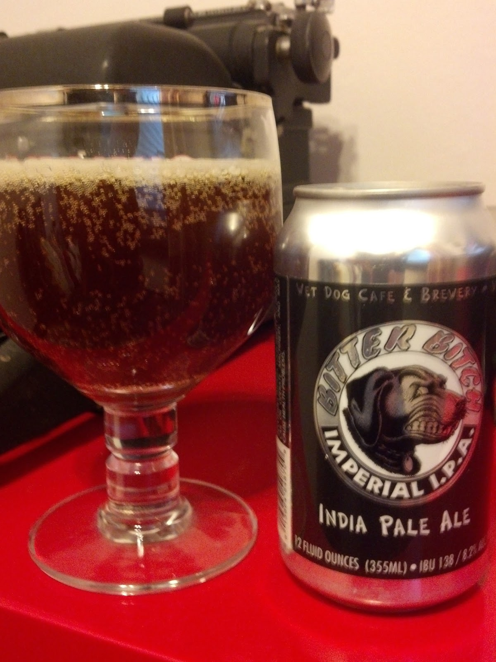
Top Beers by ABV and IBU
Top ABV: Lee Hill Series Vol. 5
Upslope Brewing Company
Boulder, Colorado
12.8% ABV
Belgian Style Quadrupel Ale
Top IBU: Bitter Bitch Imperial IPA
Astoria Brewing Company
Astoria, Oregon
138 IBUs
American Double/Imperial IPA

Slide 7
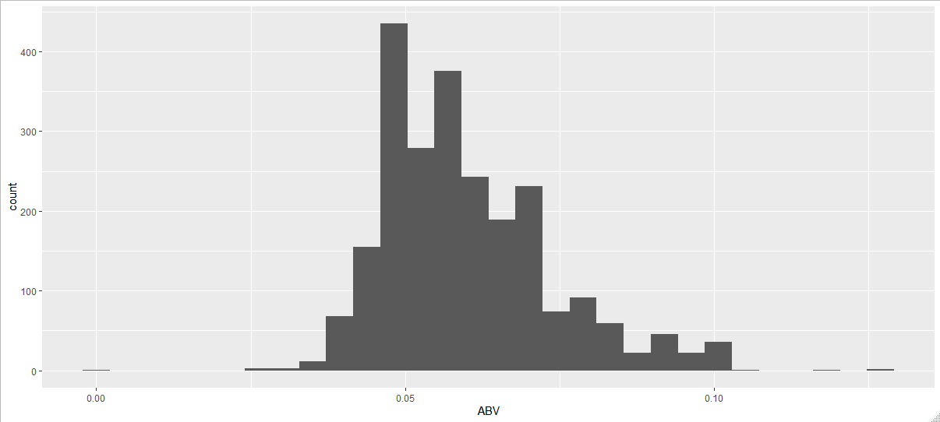
ABV Summary Statistics
Min: .01%, Max: 12.8%
Mean: 5.98%, Median: 5.6%
Peaks right before 5% and right after
Consistent with ABVs of light lagers and slightly heavier beers

Slide 8
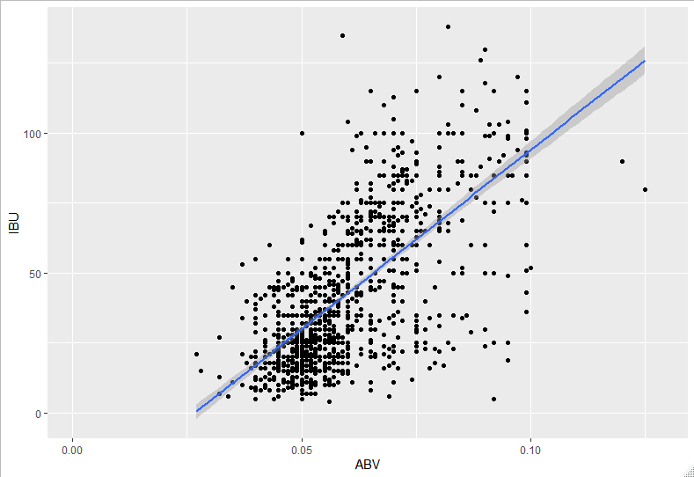
ABV vs. IBU Correlation
The two appear to be positively correlated

Slide 9
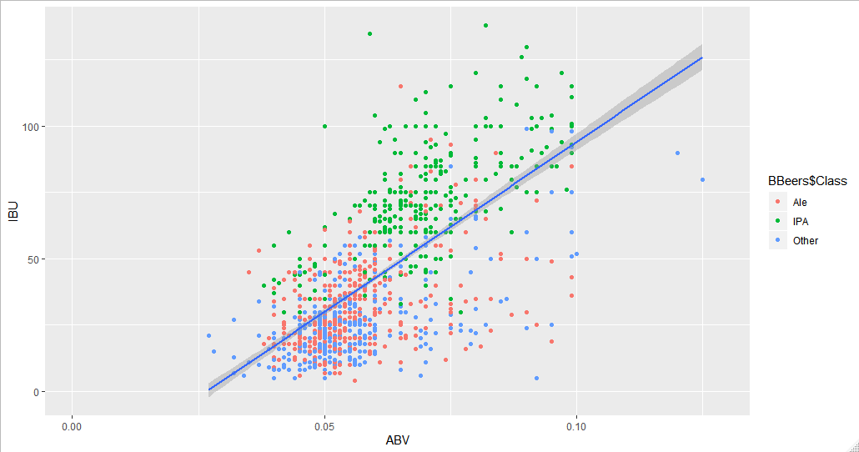
Classifying IPAs, Ales, and Other Beers

